Slide 1
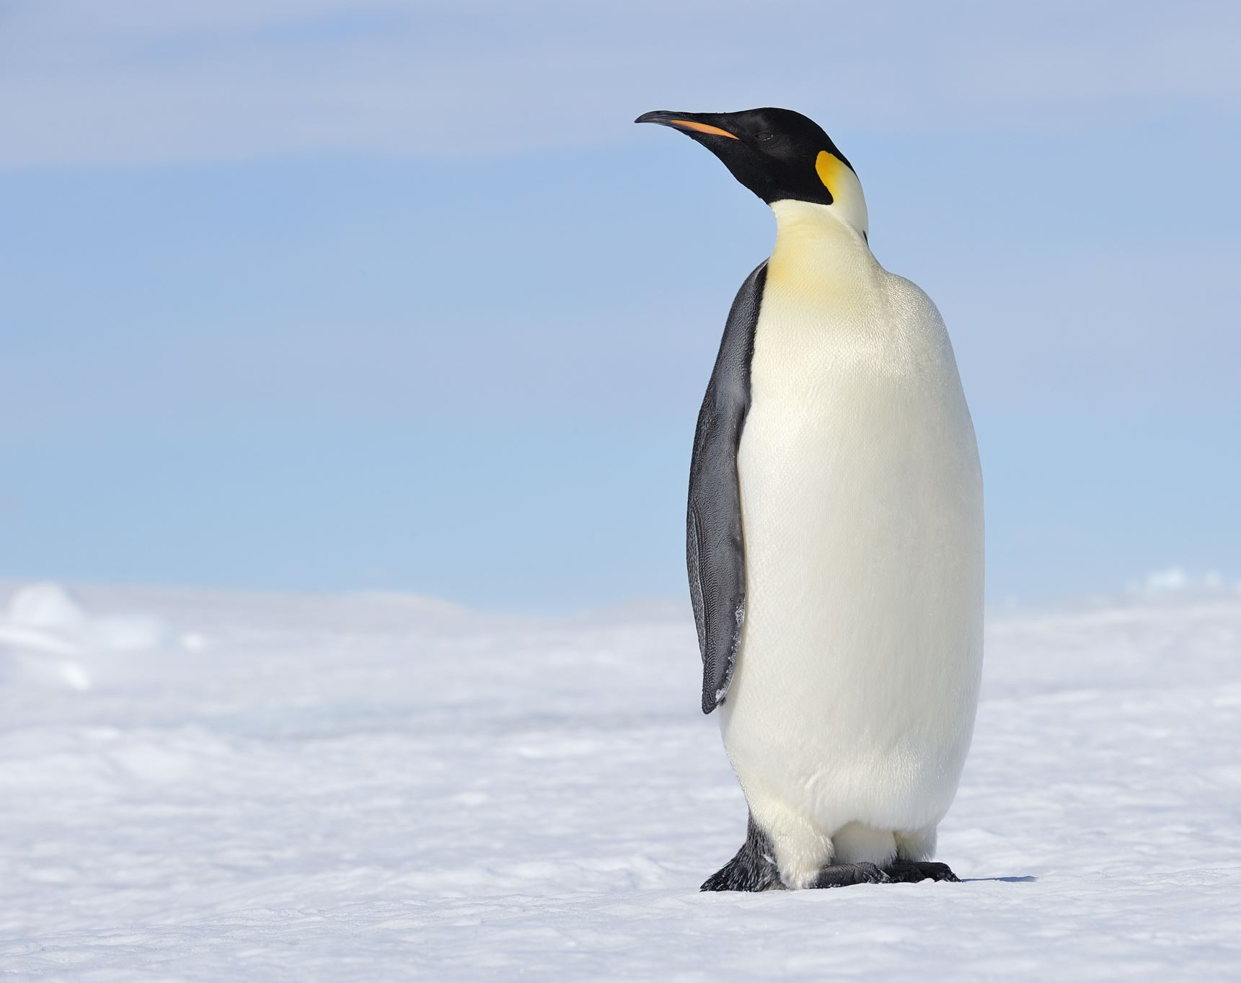
Anaconda Environment

Slide 2
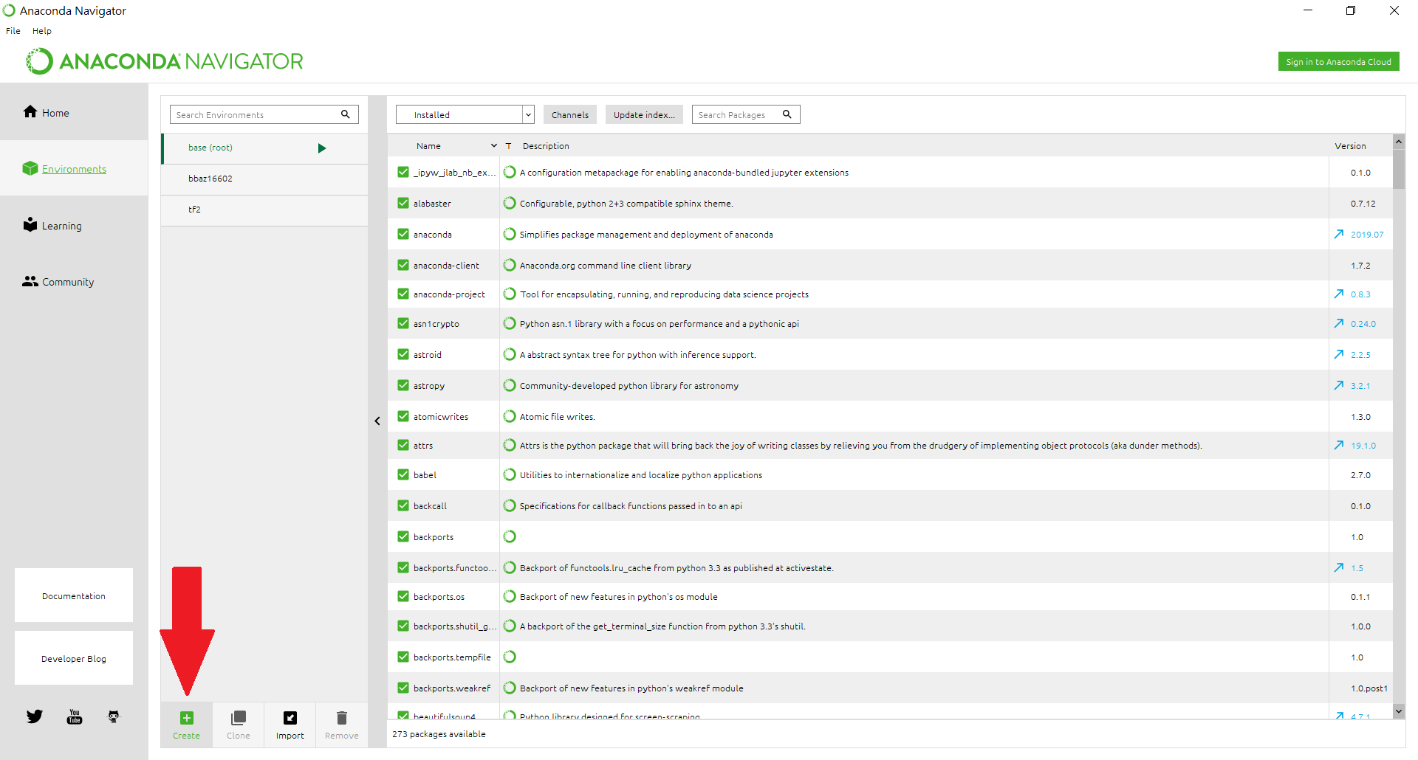
Create a New Environment

Slide 3
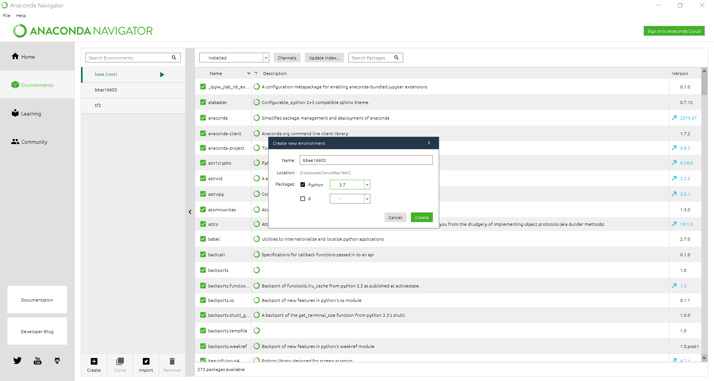
Use Any Name You Like, Choose Python 3.7

Slide 4
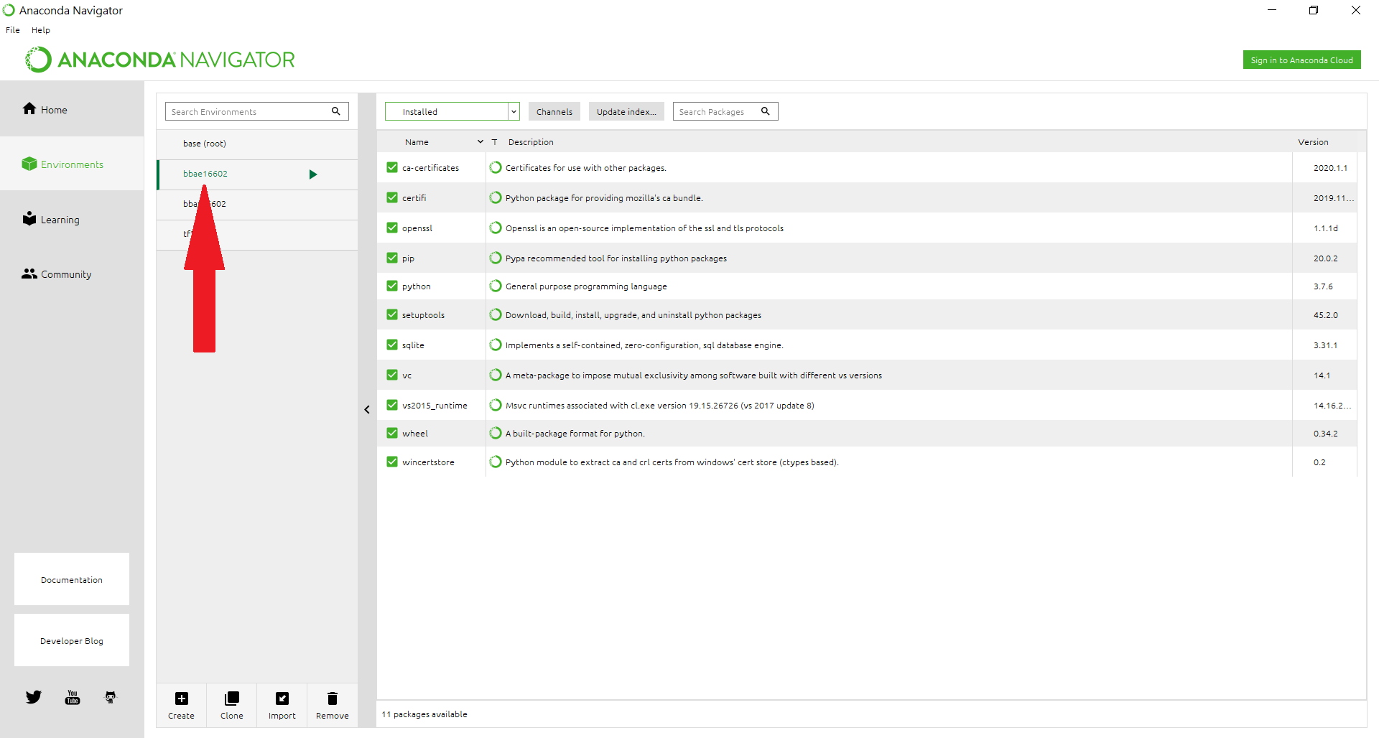
Now You Have Created Your Own Environment

Slide 5
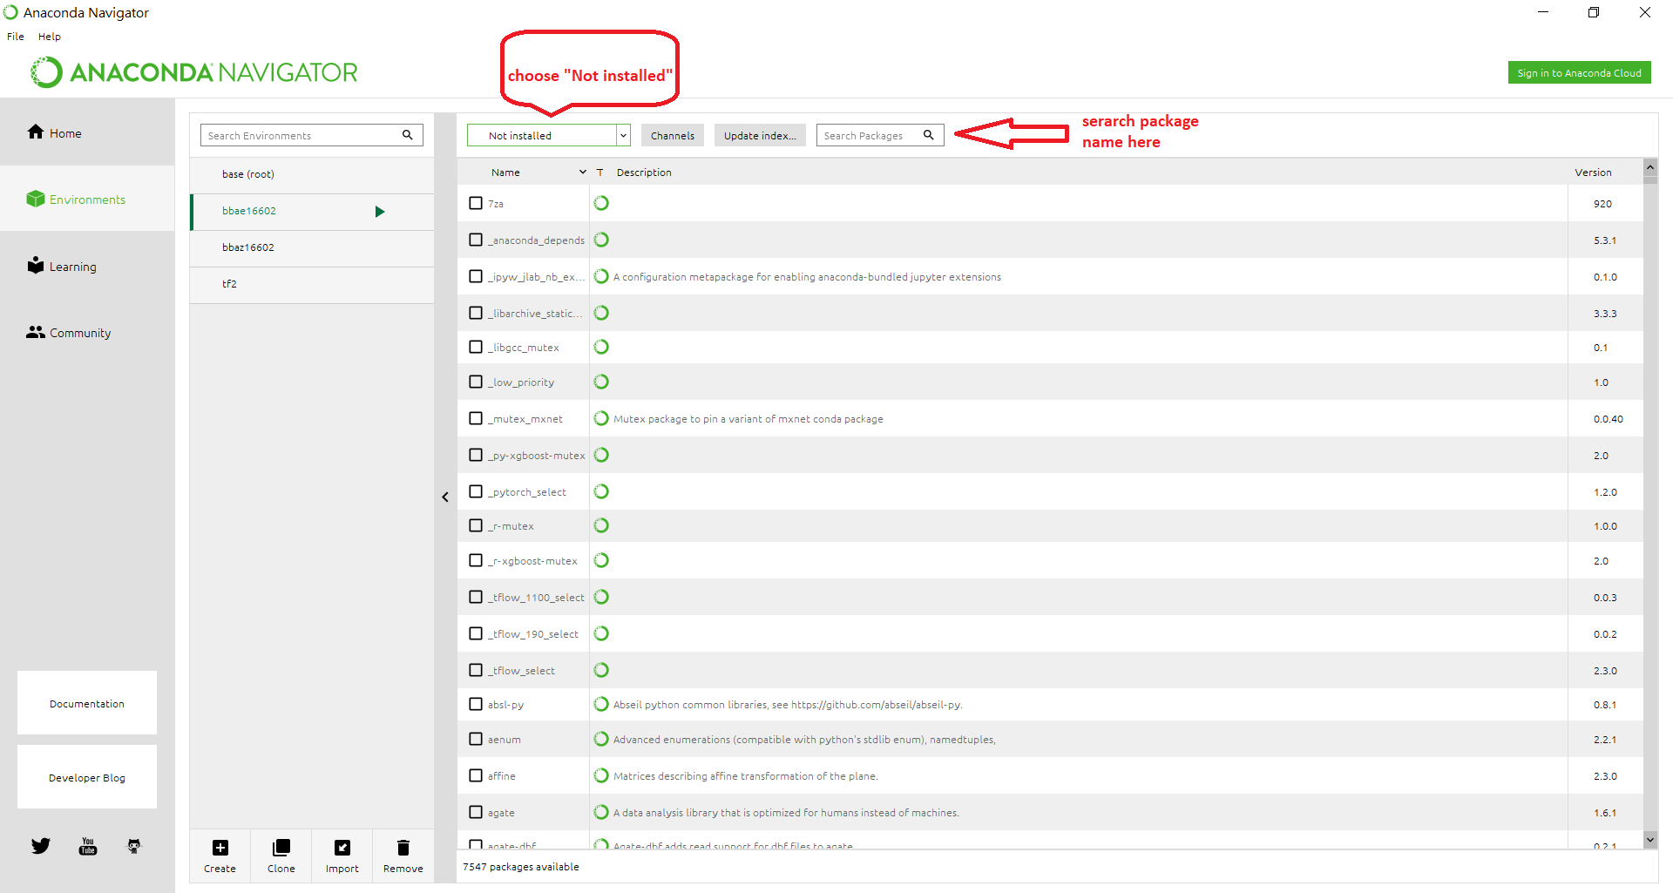
Install Packages

Slide 6
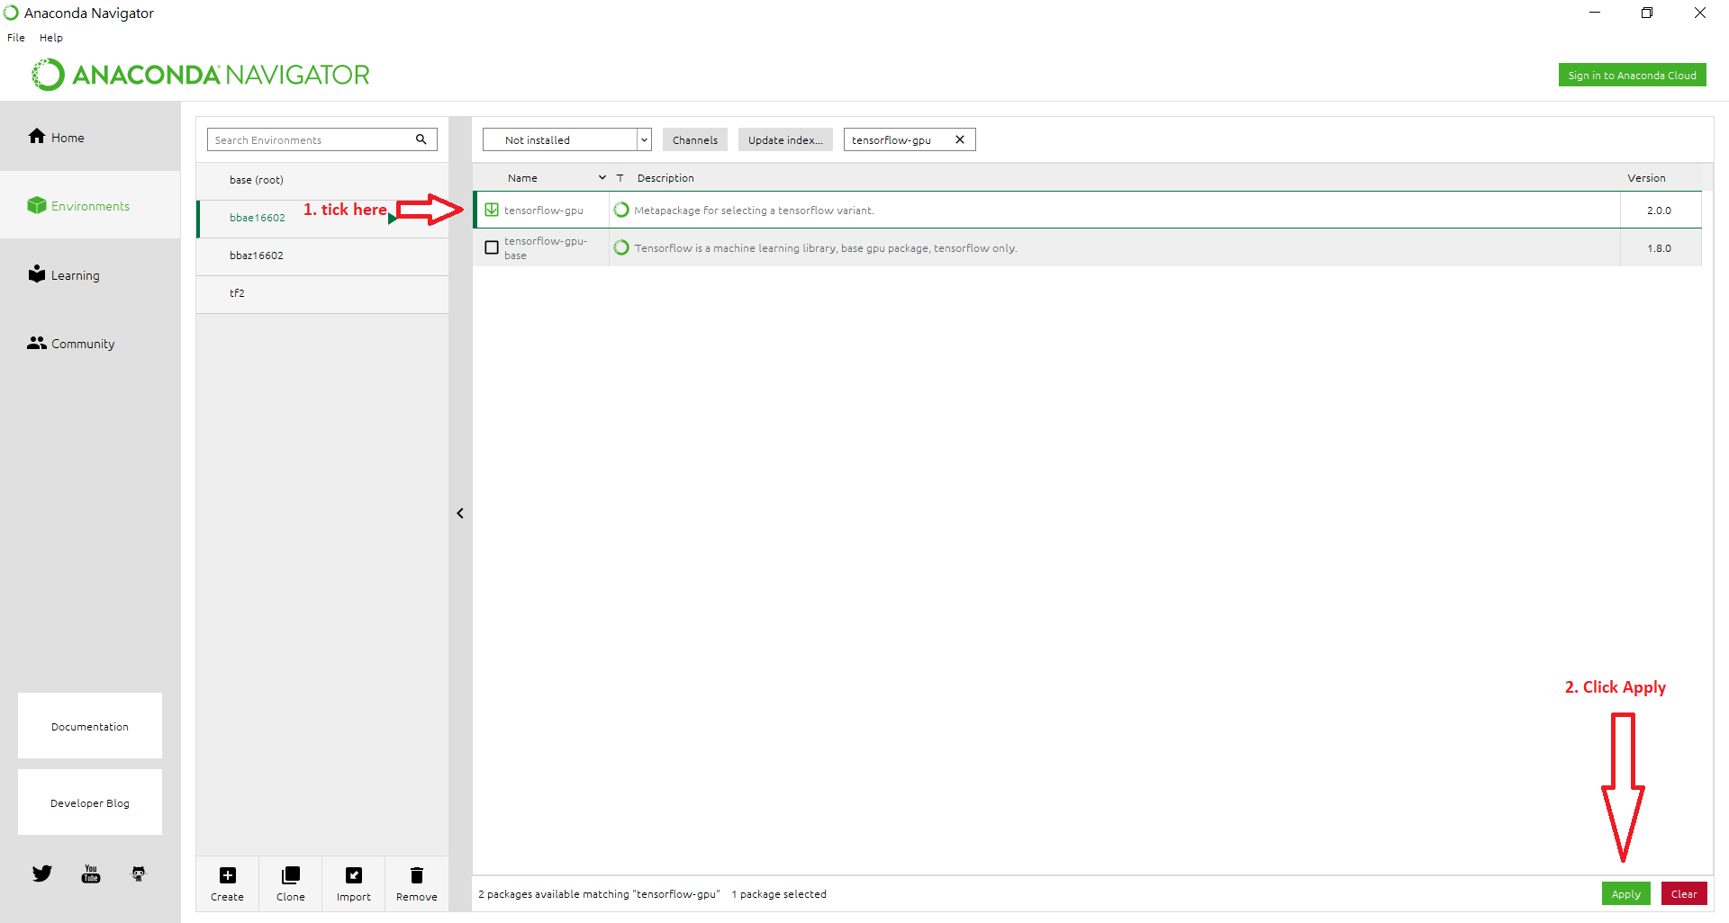
Install tensorflow-gpu

Slide 7
Similar for the Other Packages
scikit-learn
pandas
numpy
matplotlib

